Slide 1
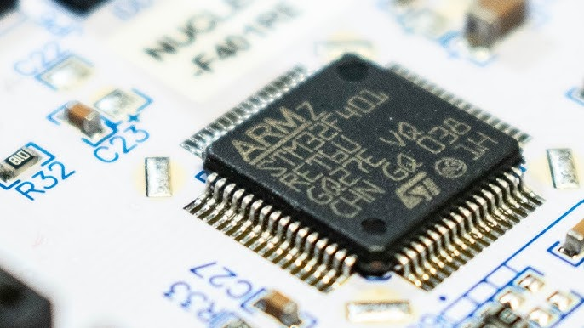
Design With Microprocessors C2

Slide 2
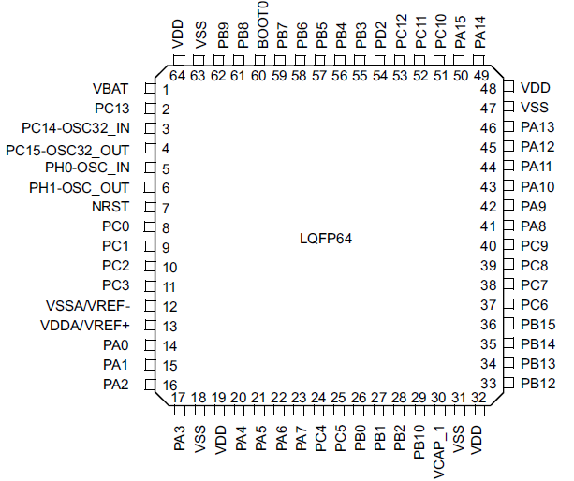
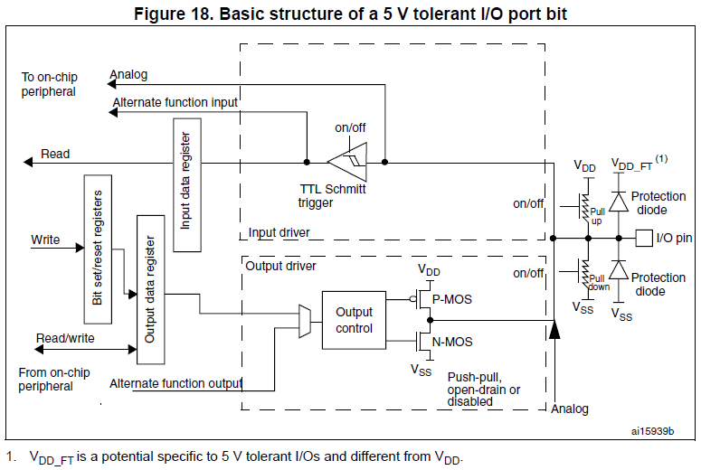
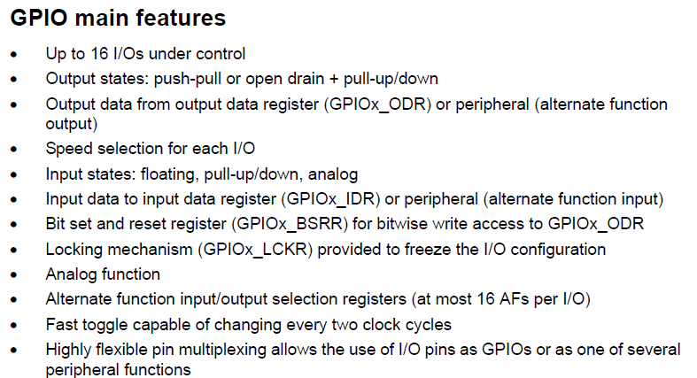
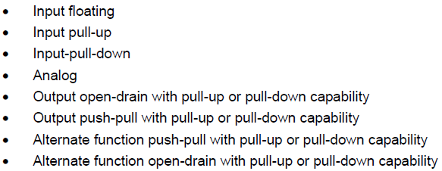
Design With Microprocessors C2
STM32F446x RM0390 Reference manual
General-purpose I/Os (GPIO)

Slide 3
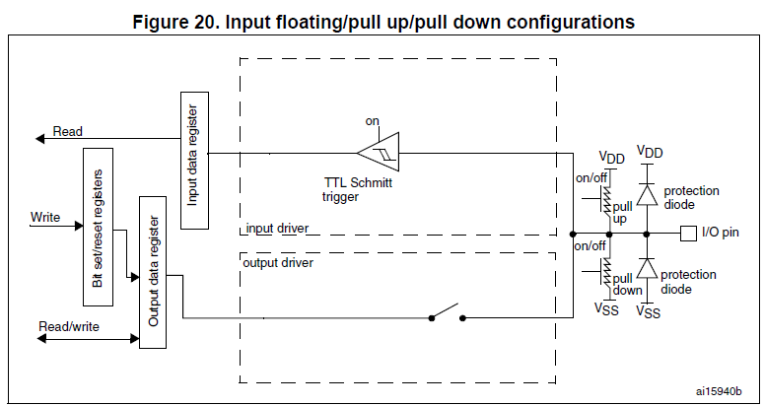
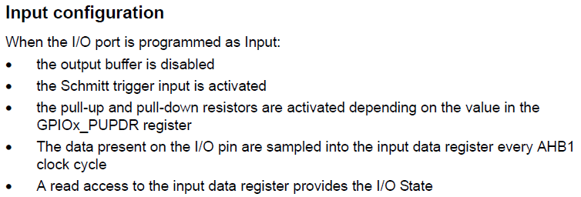
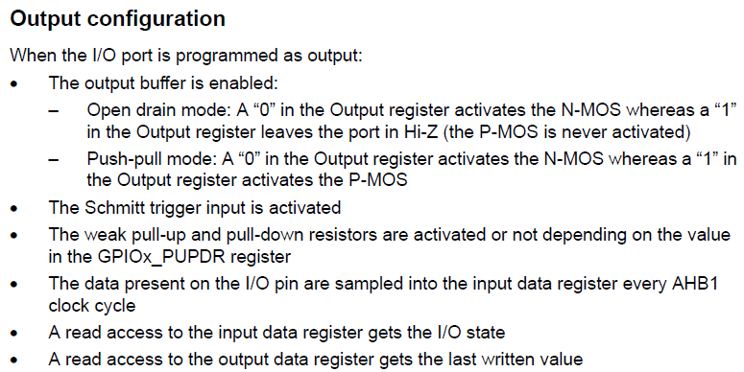
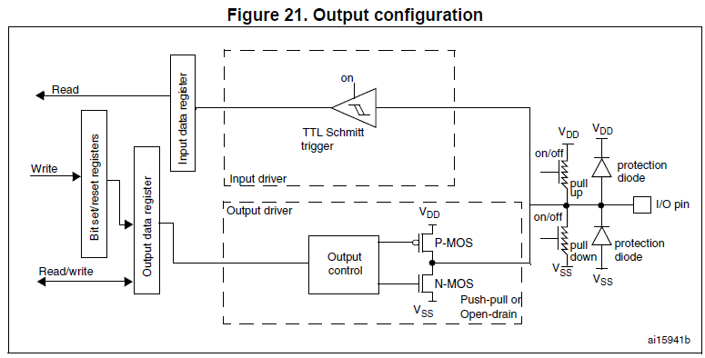
Design With Microprocessors C2
STM32F446x RM0390 Reference manual
General-purpose I/Os (GPIO)

Slide 4
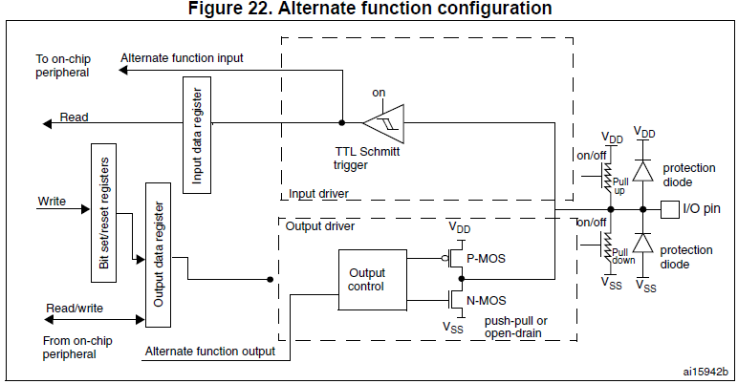
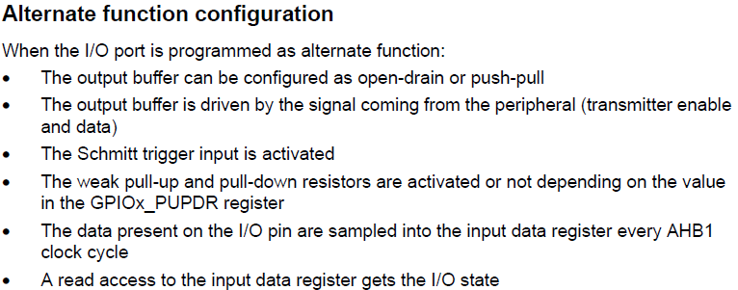
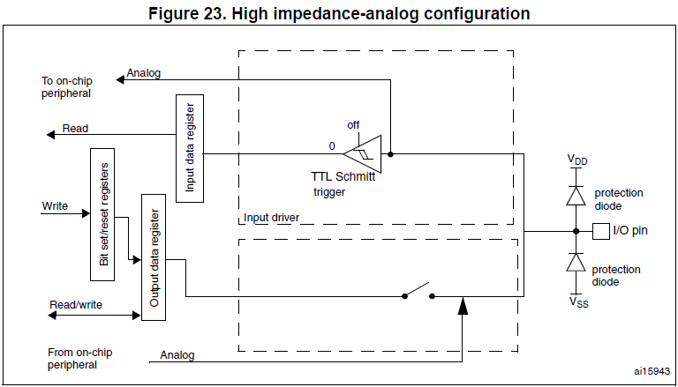
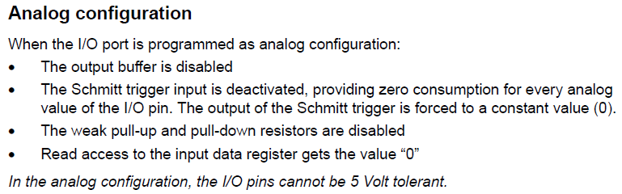
Design With Microprocessors C2
STM32F446x RM0390 Reference manual
General-purpose I/Os (GPIO)

Slide 5
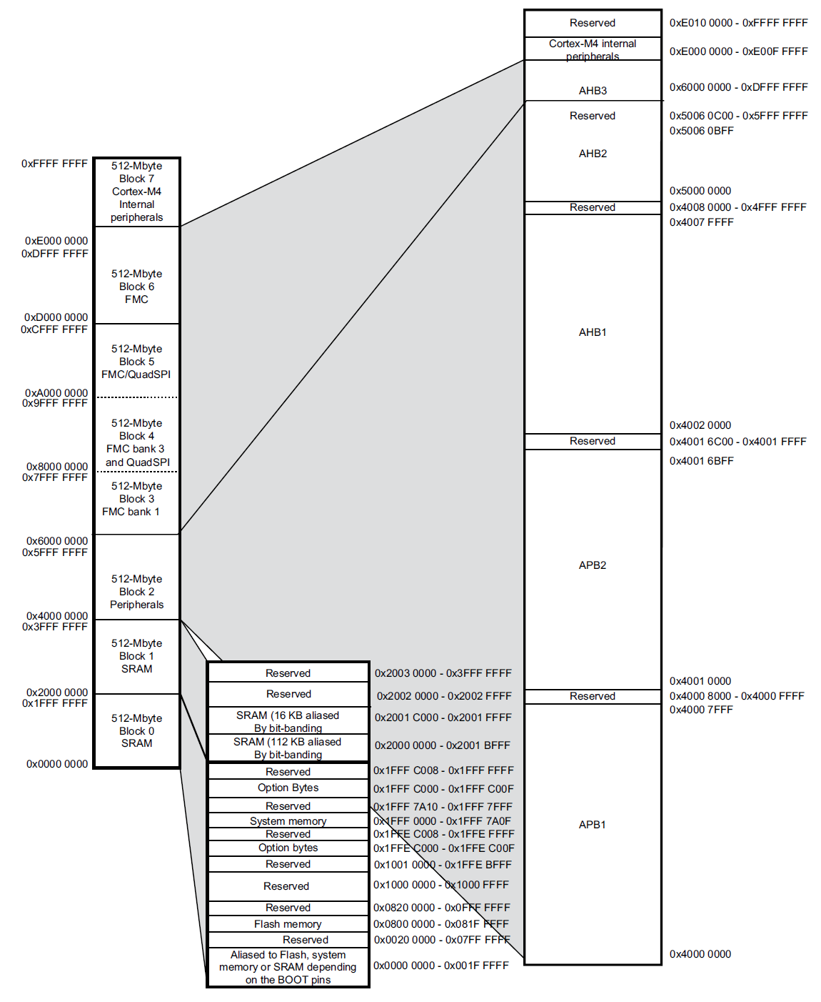
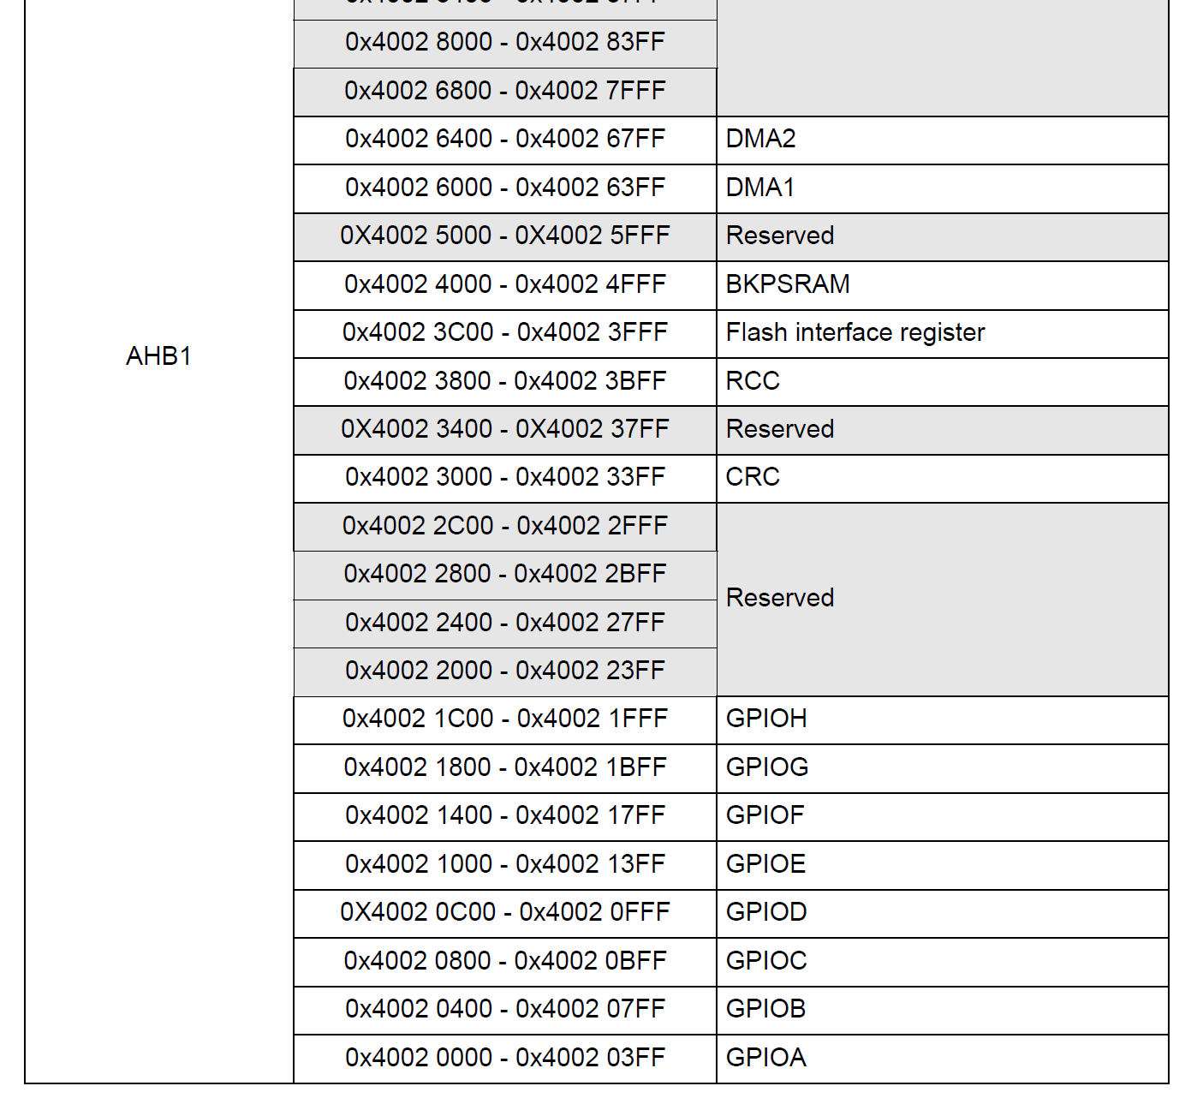
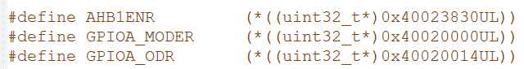
Design With Microprocessors C2

Slide 6
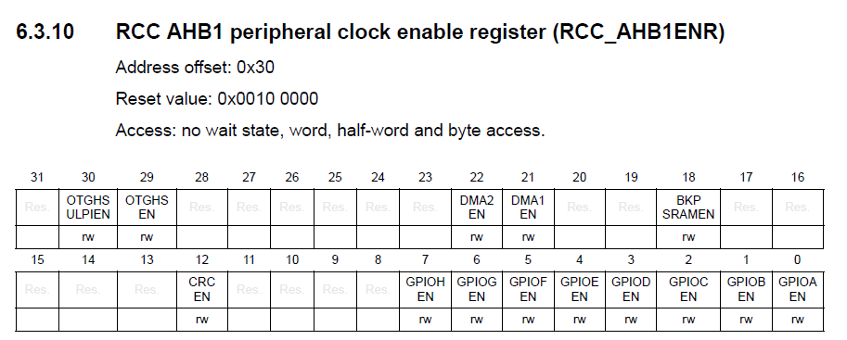
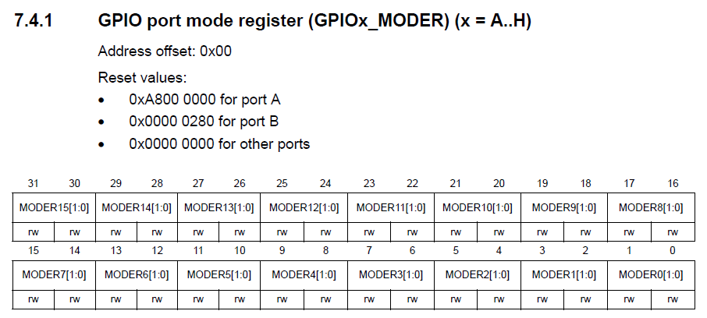
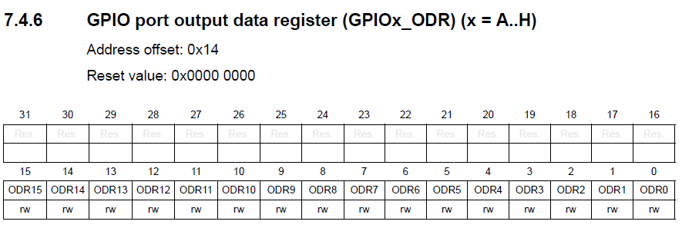
Design With Microprocessors C2

Slide 7
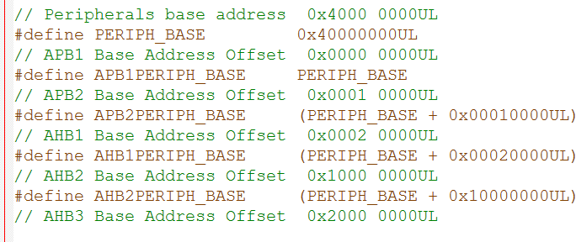
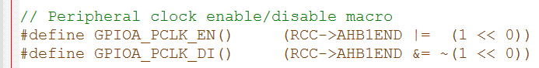
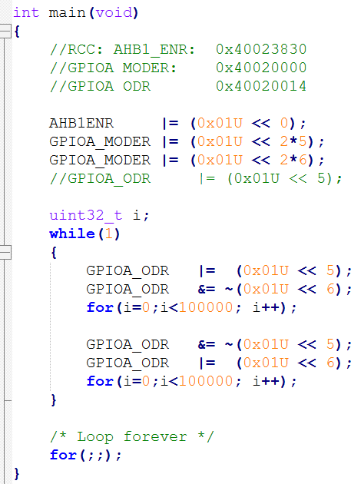
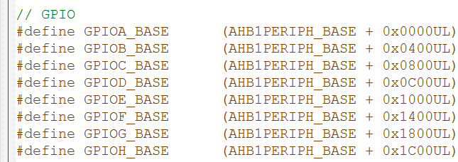
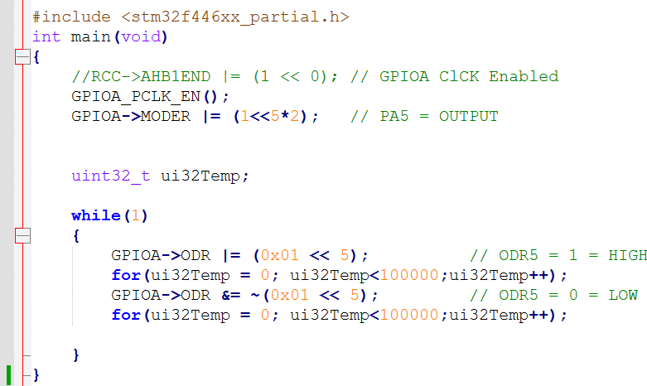
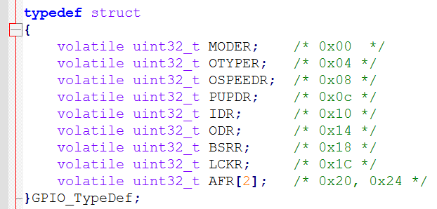
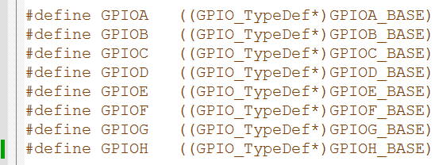
Design With Microprocessors C2

Slide 8
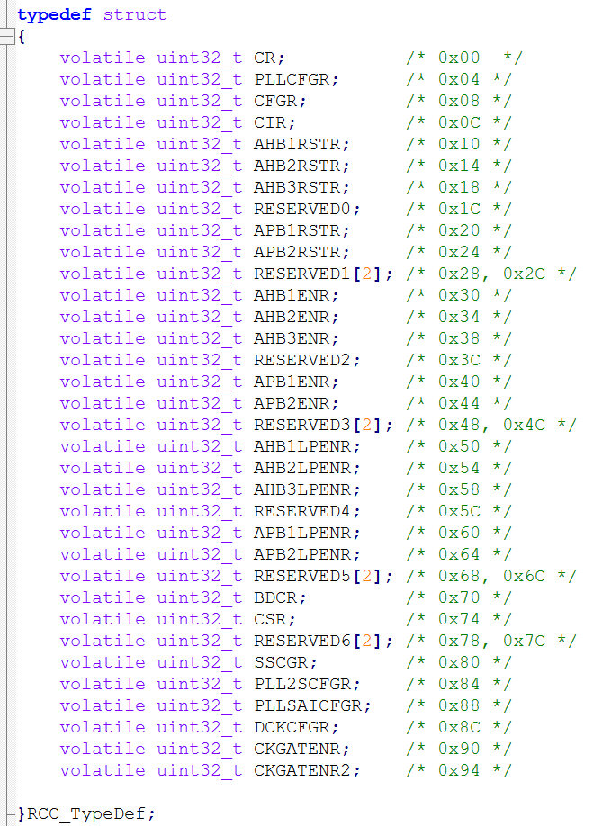
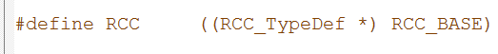
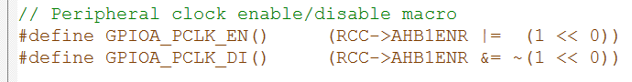
Design With Microprocessors C2

Slide 9
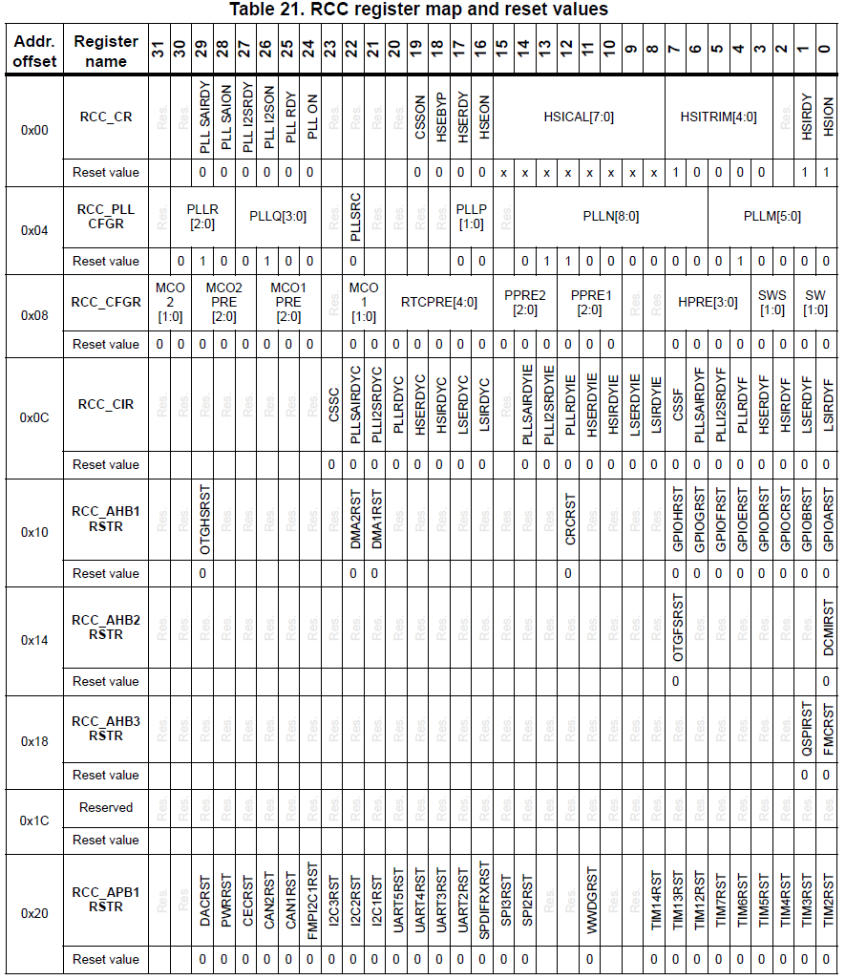
Design With Microprocessors C2

Slide 10
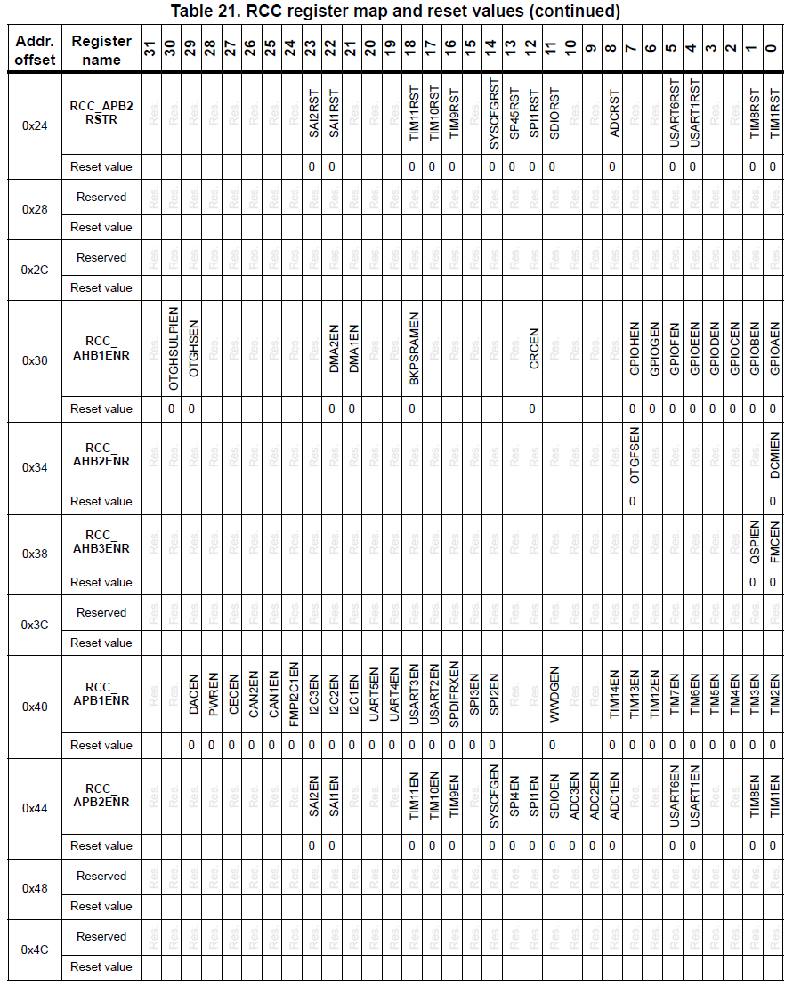
Design With Microprocessors C2

Slide 11
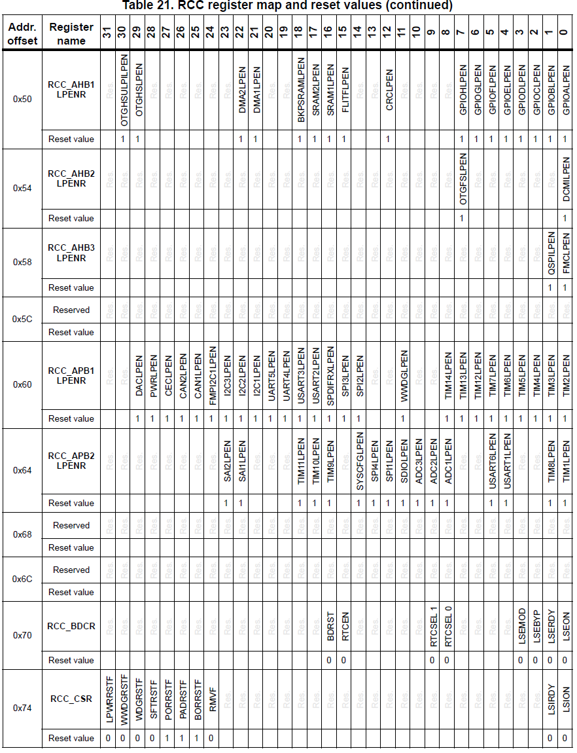
Design With Microprocessors C2

Slide 12
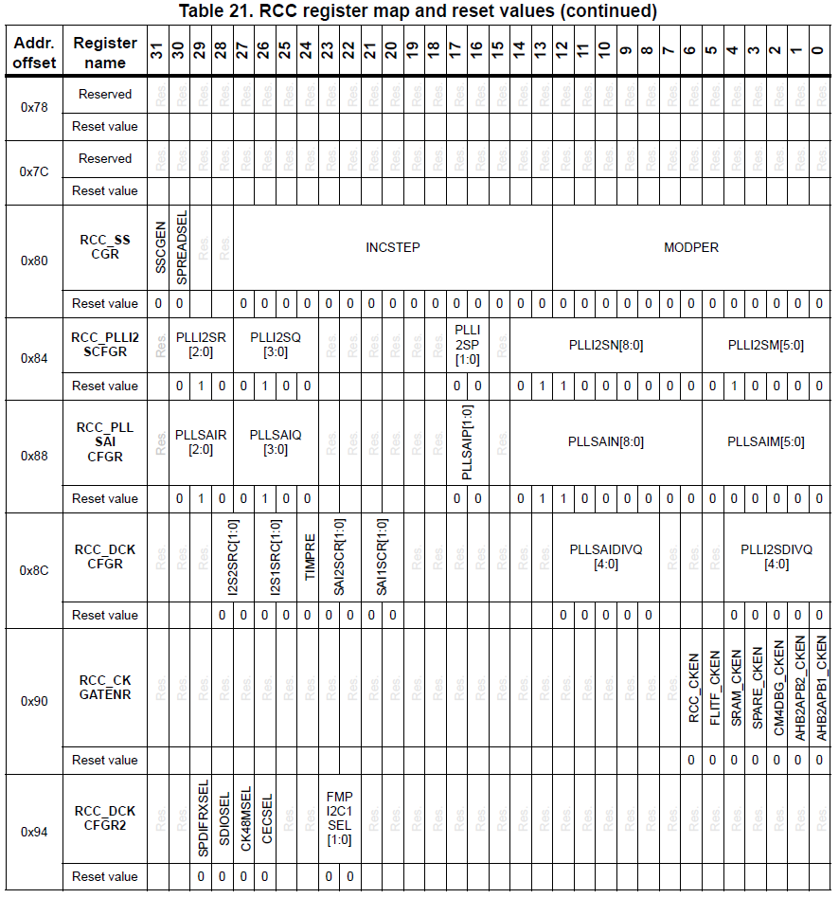
Design With Microprocessors C2

Slide 13
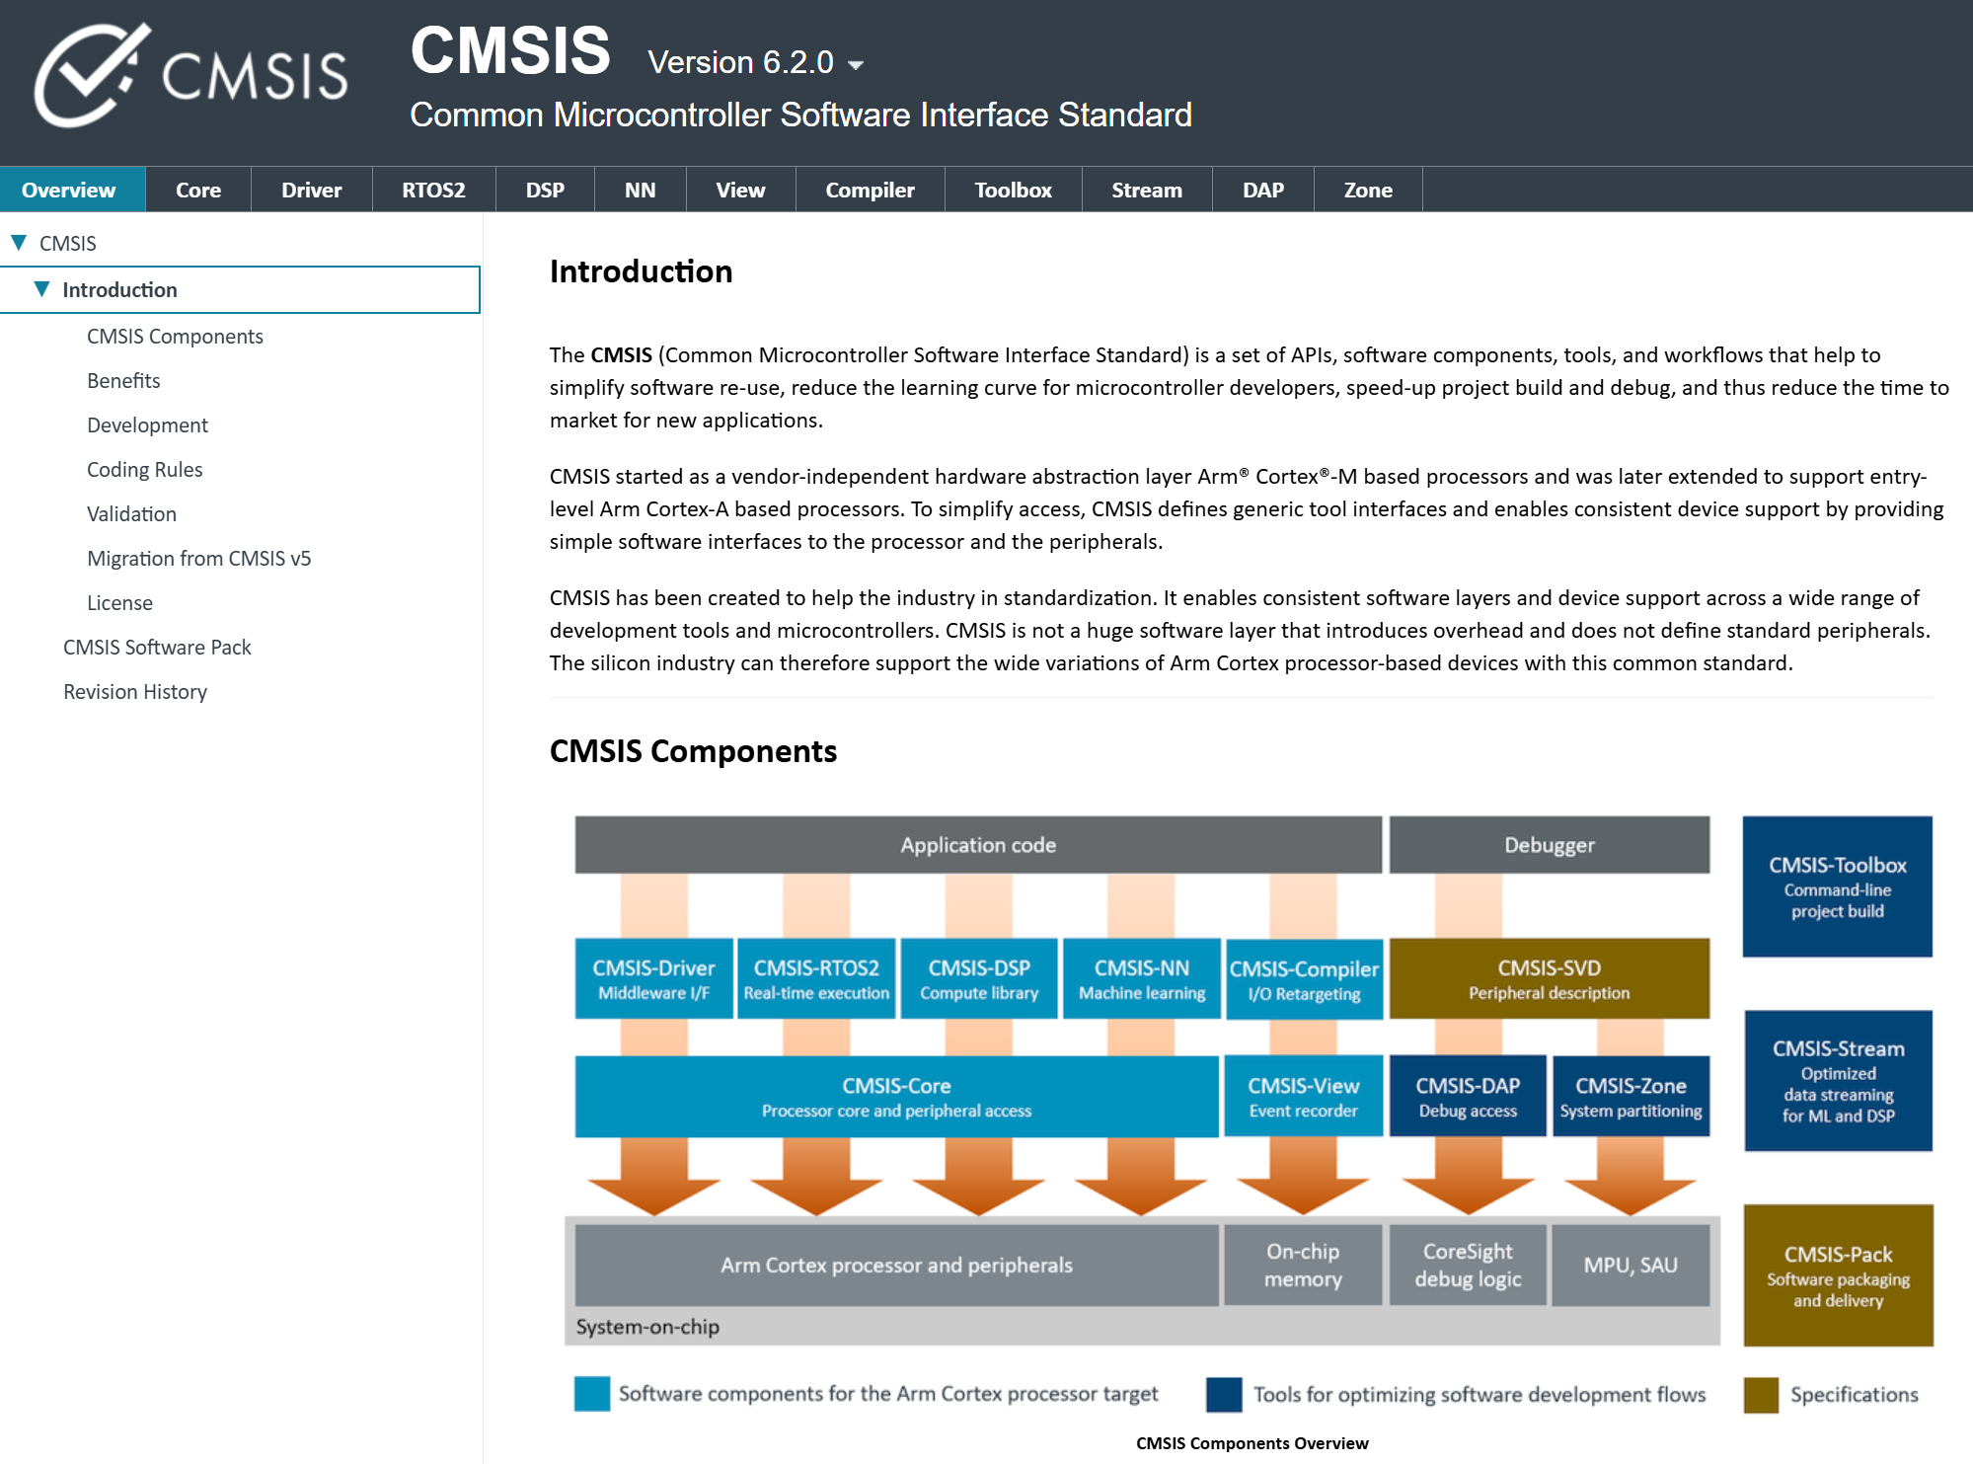
Design With Microprocessors C2
https://arm-software.github.io/CMSIS_6/latest/General/index.html

Slide 14
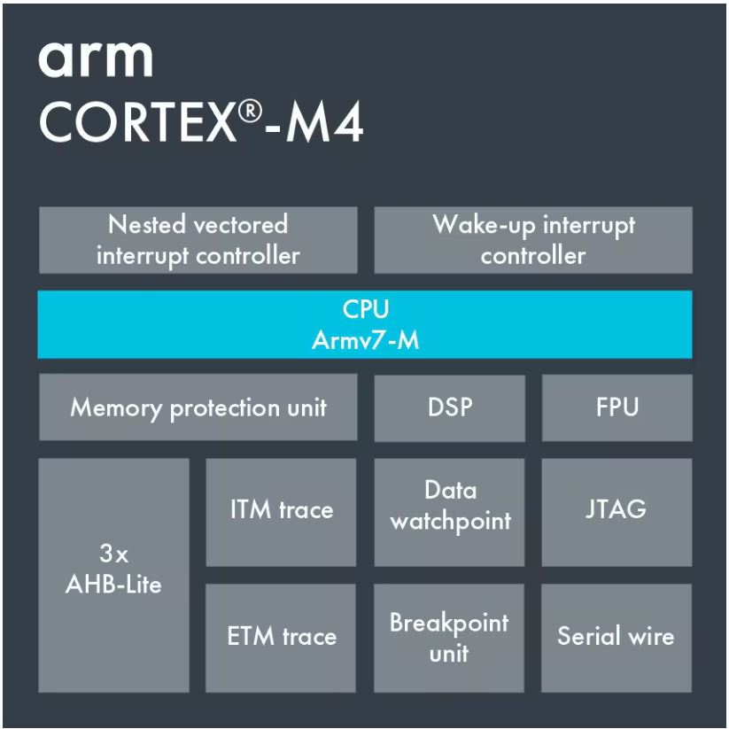
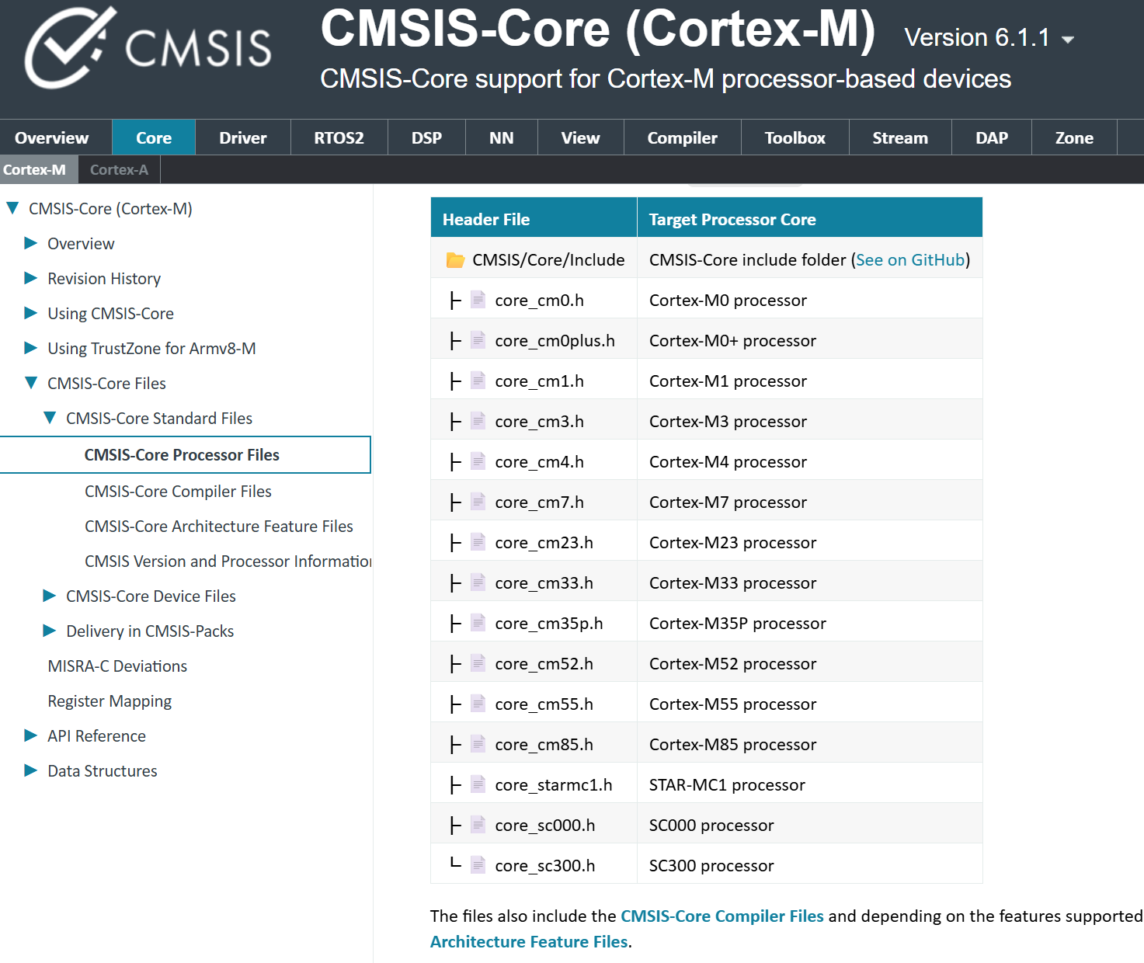
Design With Microprocessors C2
https://arm-software.github.io/CMSIS_6/latest/General/index.html

Slide 15
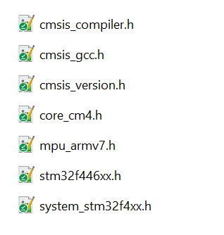
Design With Microprocessors C2
stm32f446xx.h
core_cm4.h

Slide 16
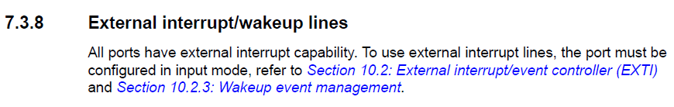
Design With Microprocessors C2
External Interrupts
General-purpose I/Os (GPIO)
GPIO
SYSCFG
EXTI
NVIC
Cortex M4
RCC
ST
SCB
ARM

Slide 17
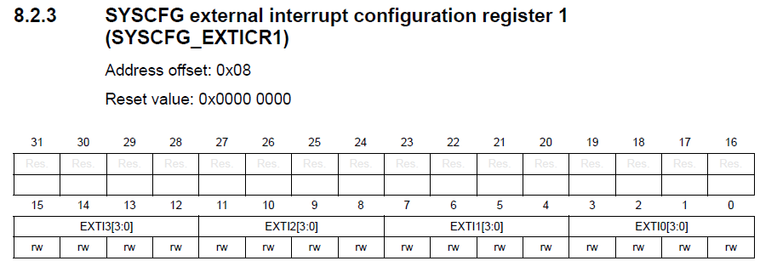
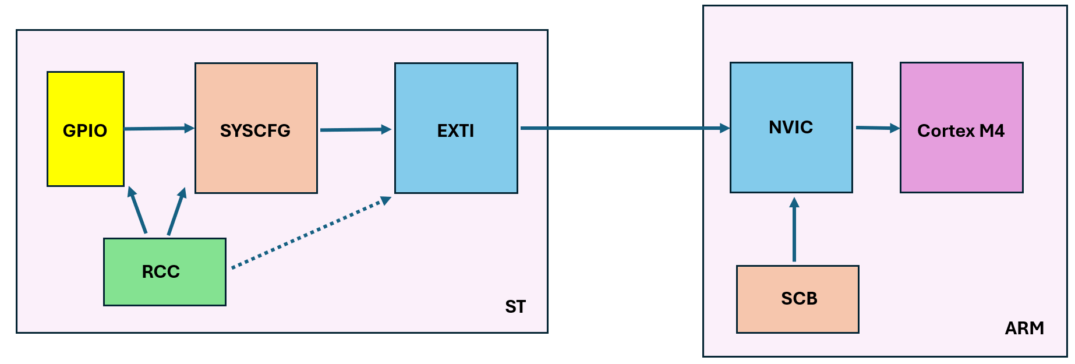
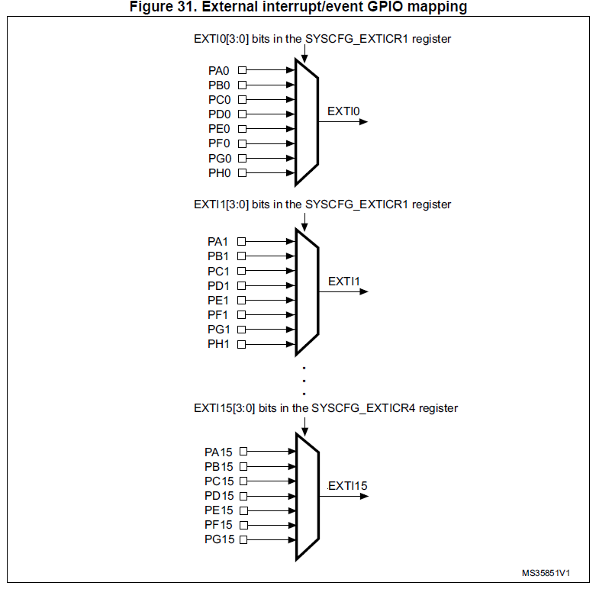
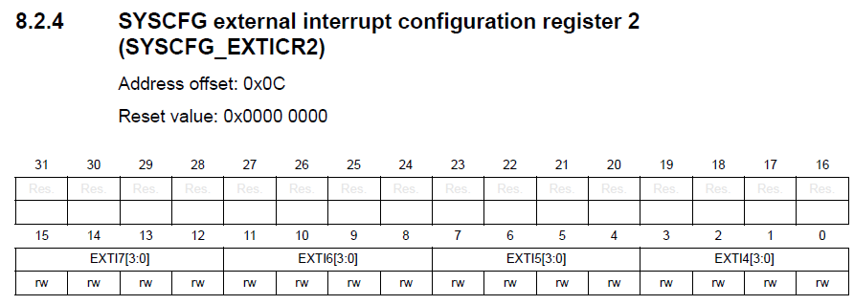
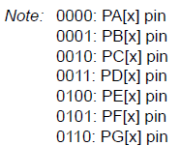
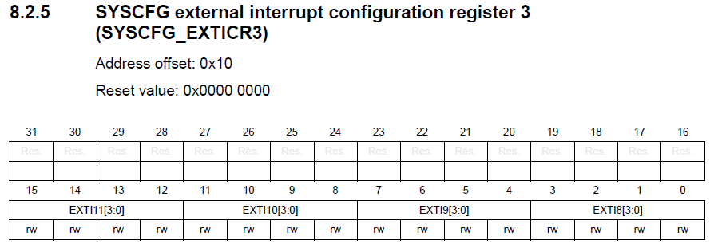
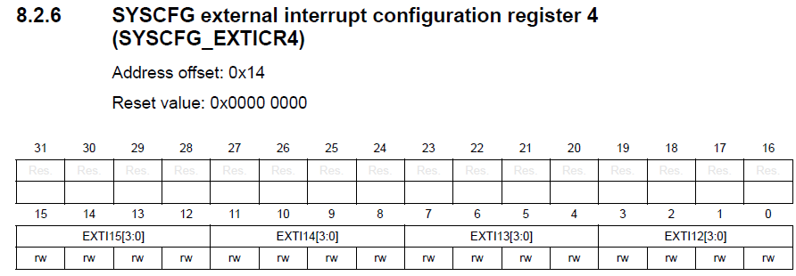
Design With Microprocessors C2
External Interrupts
SYSCFG

Slide 18
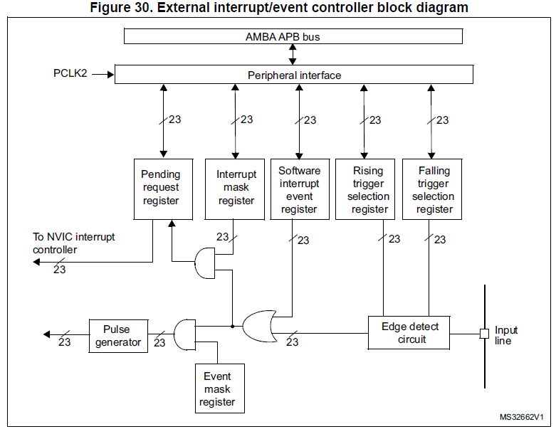
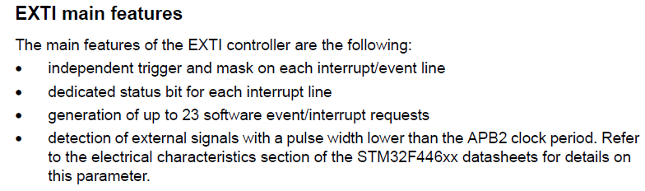
Design With Microprocessors C2
External Interrupts
EXTI

Slide 19
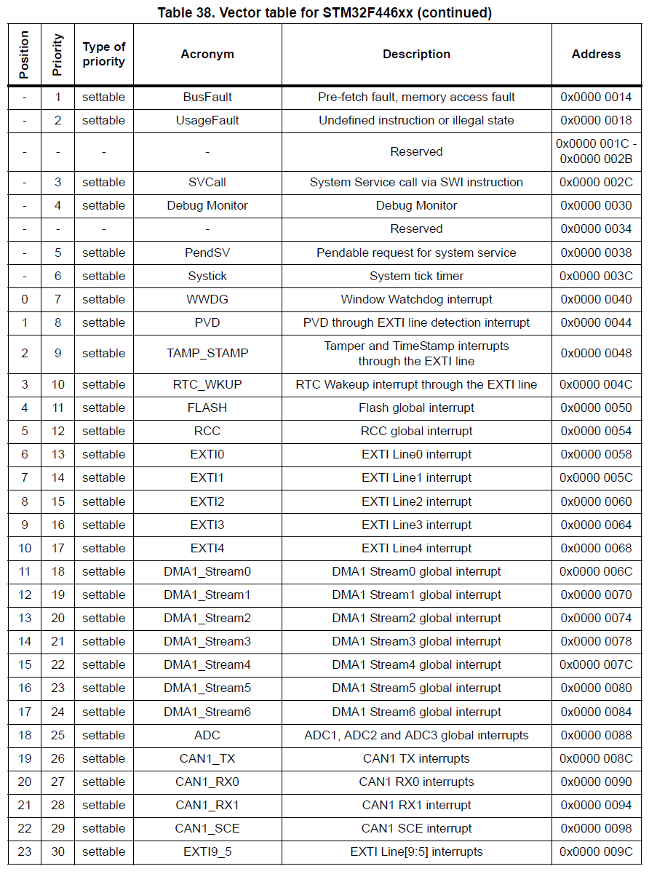
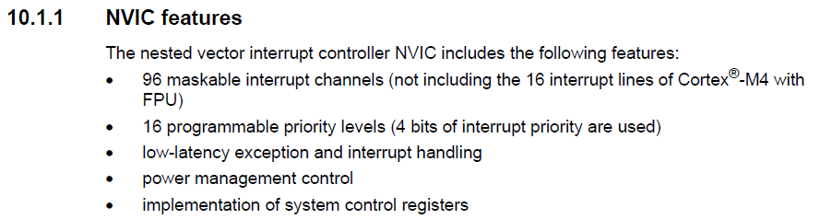
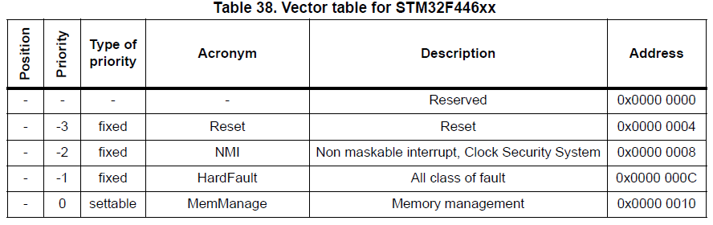
Design With Microprocessors C2
External Interrupts
NVIC

Slide 20


Design With Microprocessors C2
External Interrupts
NVIC

Slide 21


Design With Microprocessors C2
External Interrupts
NVIC

Slide 22



Design With Microprocessors C2
External Interrupts
SCB

Slide 23


Design With Microprocessors C2
External Interrupts
Cortex M4

Slide 24

Design With Microprocessors C2
External Interrupts
Cortex M4

Slide 25
Design With Microprocessors C2
External Interrupts

